Slide 1
Area Moments of Inertia via Integration
Dr. Jacob Moore
Associate Professor of Mechanical Engineering
Penn State Mont Alto

Slide 2
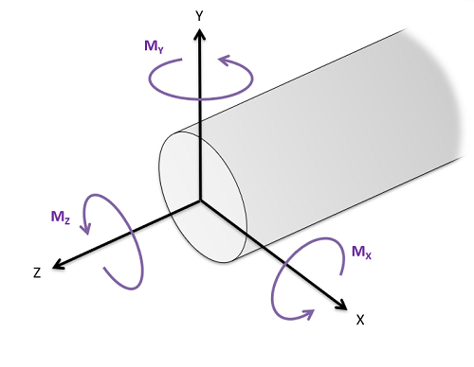
What is the Area Moment of Inertia
Area moments of inertia are used in engineering mechanics courses to determine a bodies resistance to bending loads or resistance to torsional loads.
These moments of inertia are the second area moment integrals.
The moment integral about a specific axis represents the shape’s resistance to a moment about that axis.

Slide 3
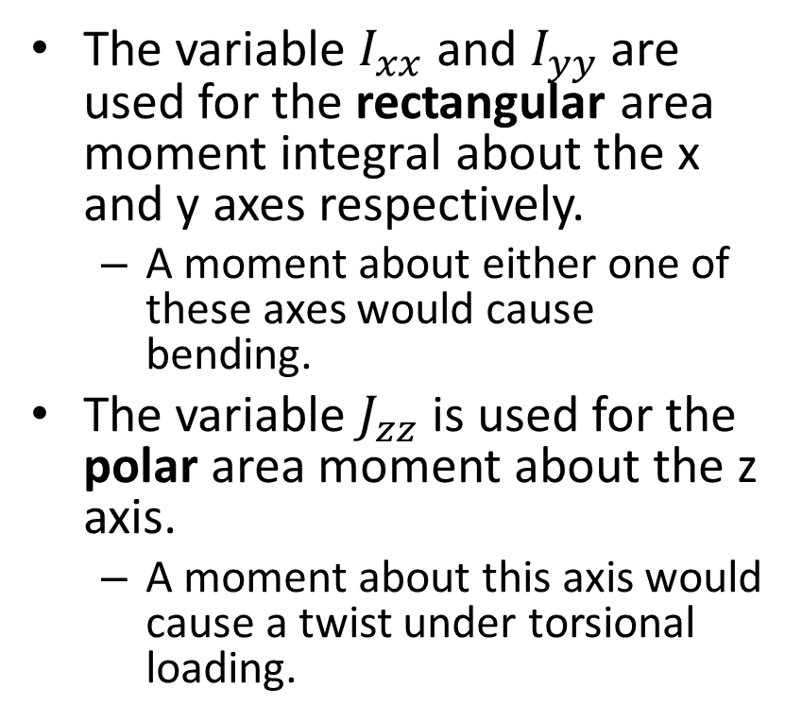
What is the Area Moment of Inertia
The variable $I_{xx}$ and $I_{yy}$ are used for the rectangular area moment integral about the x and y axes respectively.
A moment about either one of these axes would cause bending.
The variable $J_{zz}$ is used for the polar area moment about the z axis.
A moment about this axis would cause a twist under torsional loading.

Slide 4
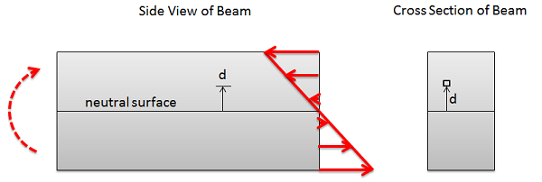
Rectangular Area Moments of Inertia and Bending
y
z
x
The diagram above shows a moment applied to a beam and the resulting internal stresses.
The second moment integral is a measure of a shape’s resistance to bending because we will need to use the sum of the internal stresses to counteract the moment applied to the beam and...
The further we are from the neutral axis, the larger the moment arm of the counteracting stress.
The further we are from the neutral axis the larger the stress itself.

Slide 5
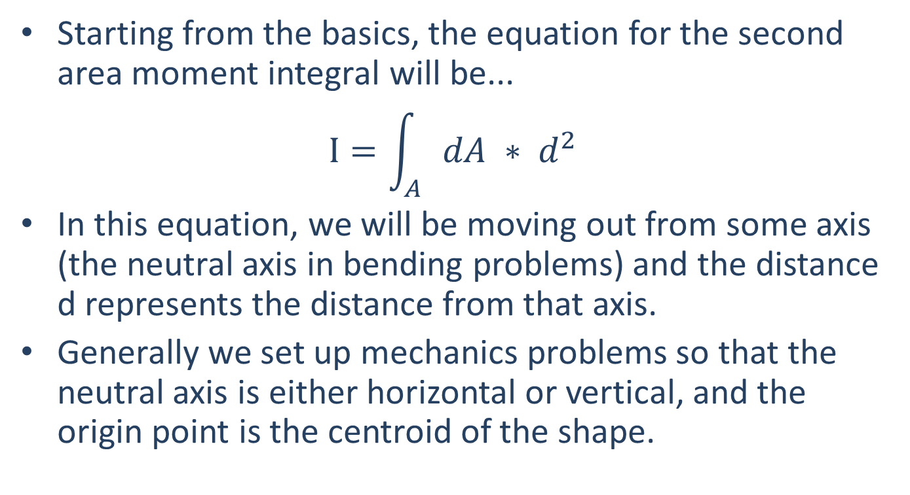
Finding the Rectangular Area Moment of Inertia via Integration
Starting from the basics, the equation for the second area moment integral will be...
$$I=\int_{A}{dA ∗ d^{2}}$$
In this equation, we will be moving out from some axis (the neutral axis in bending problems) and the distance d represents the distance from that axis.
Generally we set up mechanics problems so that the neutral axis is either horizontal or vertical, and the origin point is the centroid of the shape.

Slide 6
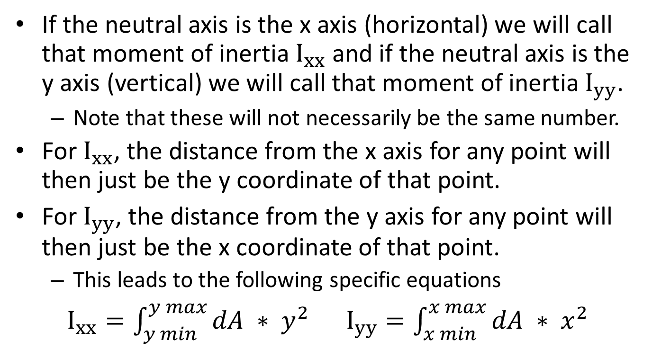
Finding the Rectangular Area Moment of Inertia via Integration
If the neutral axis is the x axis (horizontal) we will call that moment of inertia $I_{xx}$ and if the neutral axis is the y axis (vertical) we will call that moment of inertia $I_{yy}$.
Note that these will not necessarily be the same number.
For $I_{xx}$, the distance from the x axis for any point will then just be the y coordinate of that point.
For $I_{yy}$, the distance from the y axis for any point will then just be the x coordinate of that point.
This leads to the following specific equations
$I_{xx}=\int_{y min}^{y max}{dA ∗ y^{2}}$ $I_{yy}=\int_{x min}^{x max}{dA ∗ x^{2}}$

Slide 7
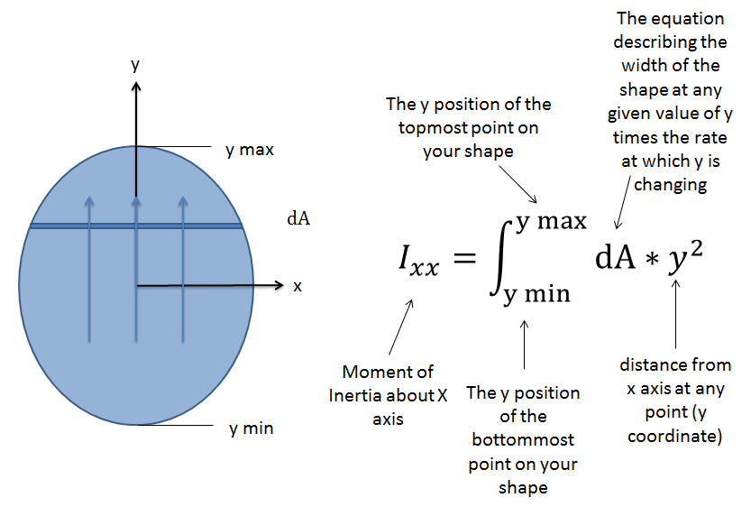
Finding the Rectangular Area Moment of Inertia via Integration

Slide 8
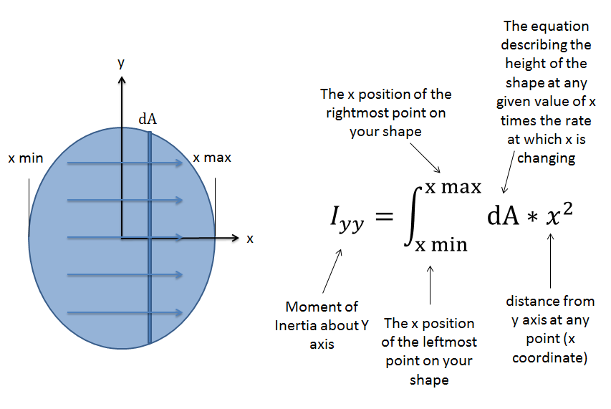
Finding the Rectangular Area Moment of Inertia via Integration

Slide 9
Polar Area Moments of Inertia and Torsion
What we usually call the ‘polar area moment of inertia’ (abbreviated as J) is the second, polar, area moment integral of a shape.
This value is useful in engineering mechanics because it offers a quantitative measure of a shape’s resistance to torsion, helping us relate torsional loads on a shaft to the shearing stresses experienced in that shaft.

Slide 10
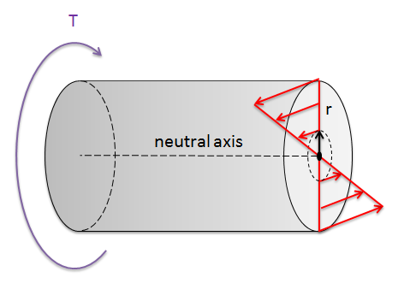
Polar Area Moments of Inertia and Torsion
The diagram above shows a torque applied to a shaft and the resulting internal stresses.
The second moment integral is a measure of a shape’s resistance to torsion because we will need to use the sum of the internal stresses to counteract the torque applied to the beam and...
The further we are from the neutral axis, the larger the moment arm of the counteracting stress.
The further we are from the neutral axis the larger the stress itself.

Slide 11
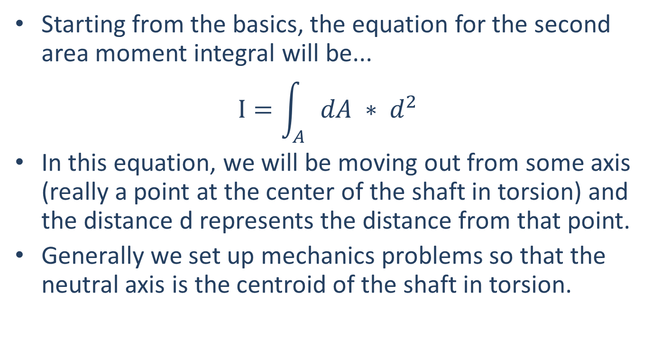
Finding the Polar Area Moment of Inertia via Integration
Starting from the basics, the equation for the second area moment integral will be...
$$I=\int_{A}{dA ∗ d^{2}}$$
In this equation, we will be moving out from some axis (really a point at the center of the shaft in torsion) and the distance d represents the distance from that point.
Generally we set up mechanics problems so that the neutral axis is the centroid of the shaft in torsion.

Slide 12
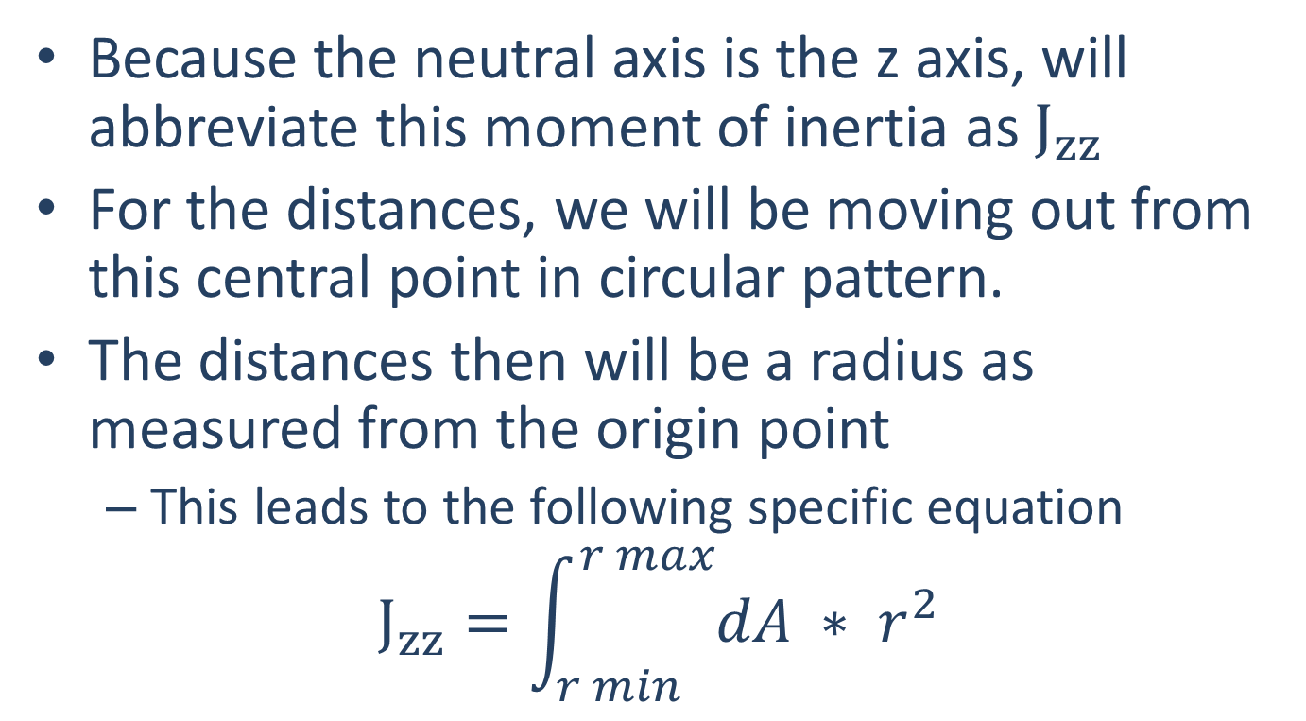
Finding the Polar Area Moment of Inertia via Integration
Because the neutral axis is the z axis, will abbreviate this moment of inertia as $J_{zz}$
For the distances, we will be moving out from this central point in circular pattern.
The distances then will be a radius as measured from the origin point
This leads to the following specific equation
$$J_{zz}=\int_{r min}^{r max}{dA ∗ r^{2}}$$

Slide 13
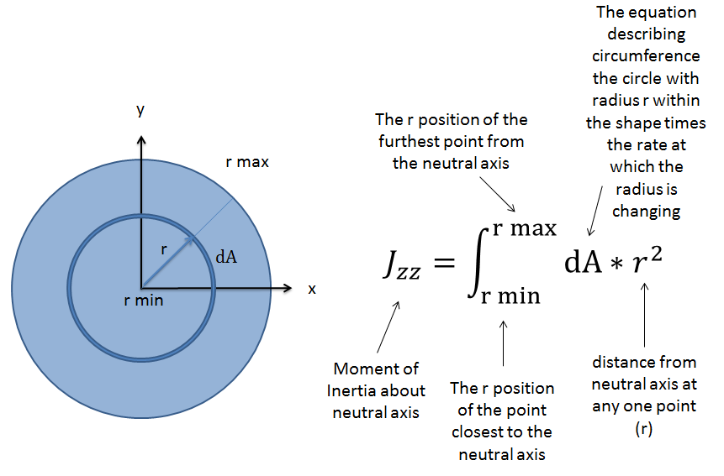
Finding the Polar Area Moment of Inertia via Integration

Slide 14
Thanks for Watching
See other engineering mechanics videos and access the full tool at…

Slide 15
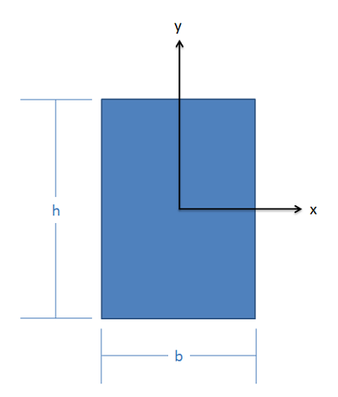
The Area Moment of Inertia by Integration Worked Example
Find the area moments of inertia for this shape about both the x and y axes though the centroid. Leave the answer in terms of the generic width (b) and height (h) of the rectangle.

Slide 16
The Area Moment of Inertia by Integration Worked Example
A one inch square piece of steel is turned 45º so that it resembles a diamond pattern as shown.
What is the moment of inertia about the x axis?
Is this shape more or less resistant to bending that the original, non-turned shape?
y
x

Slide 17
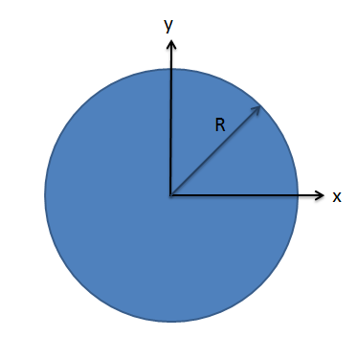
The Polar Moment of Inertia by Integration Worked Example
Find the polar moment of inertia for this circular area about its centroid. Leave the answer in terms of the generic radius R.

Slide 18
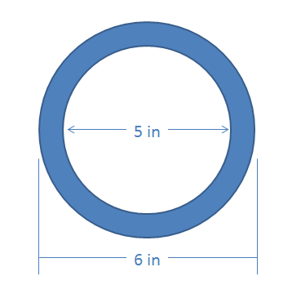
The Polar Moment of Inertia by Integration Worked Example
Find the polar moment of inertia of this hollow circular shape about its centroid.

